Slide 1
How to use DrVAEN
Website: https://bioinfo.uth.edu/drvaen/
Peilin Jia, Ruifeng Hu, Zhongming Zhao
December 12, 2022

Slide 2
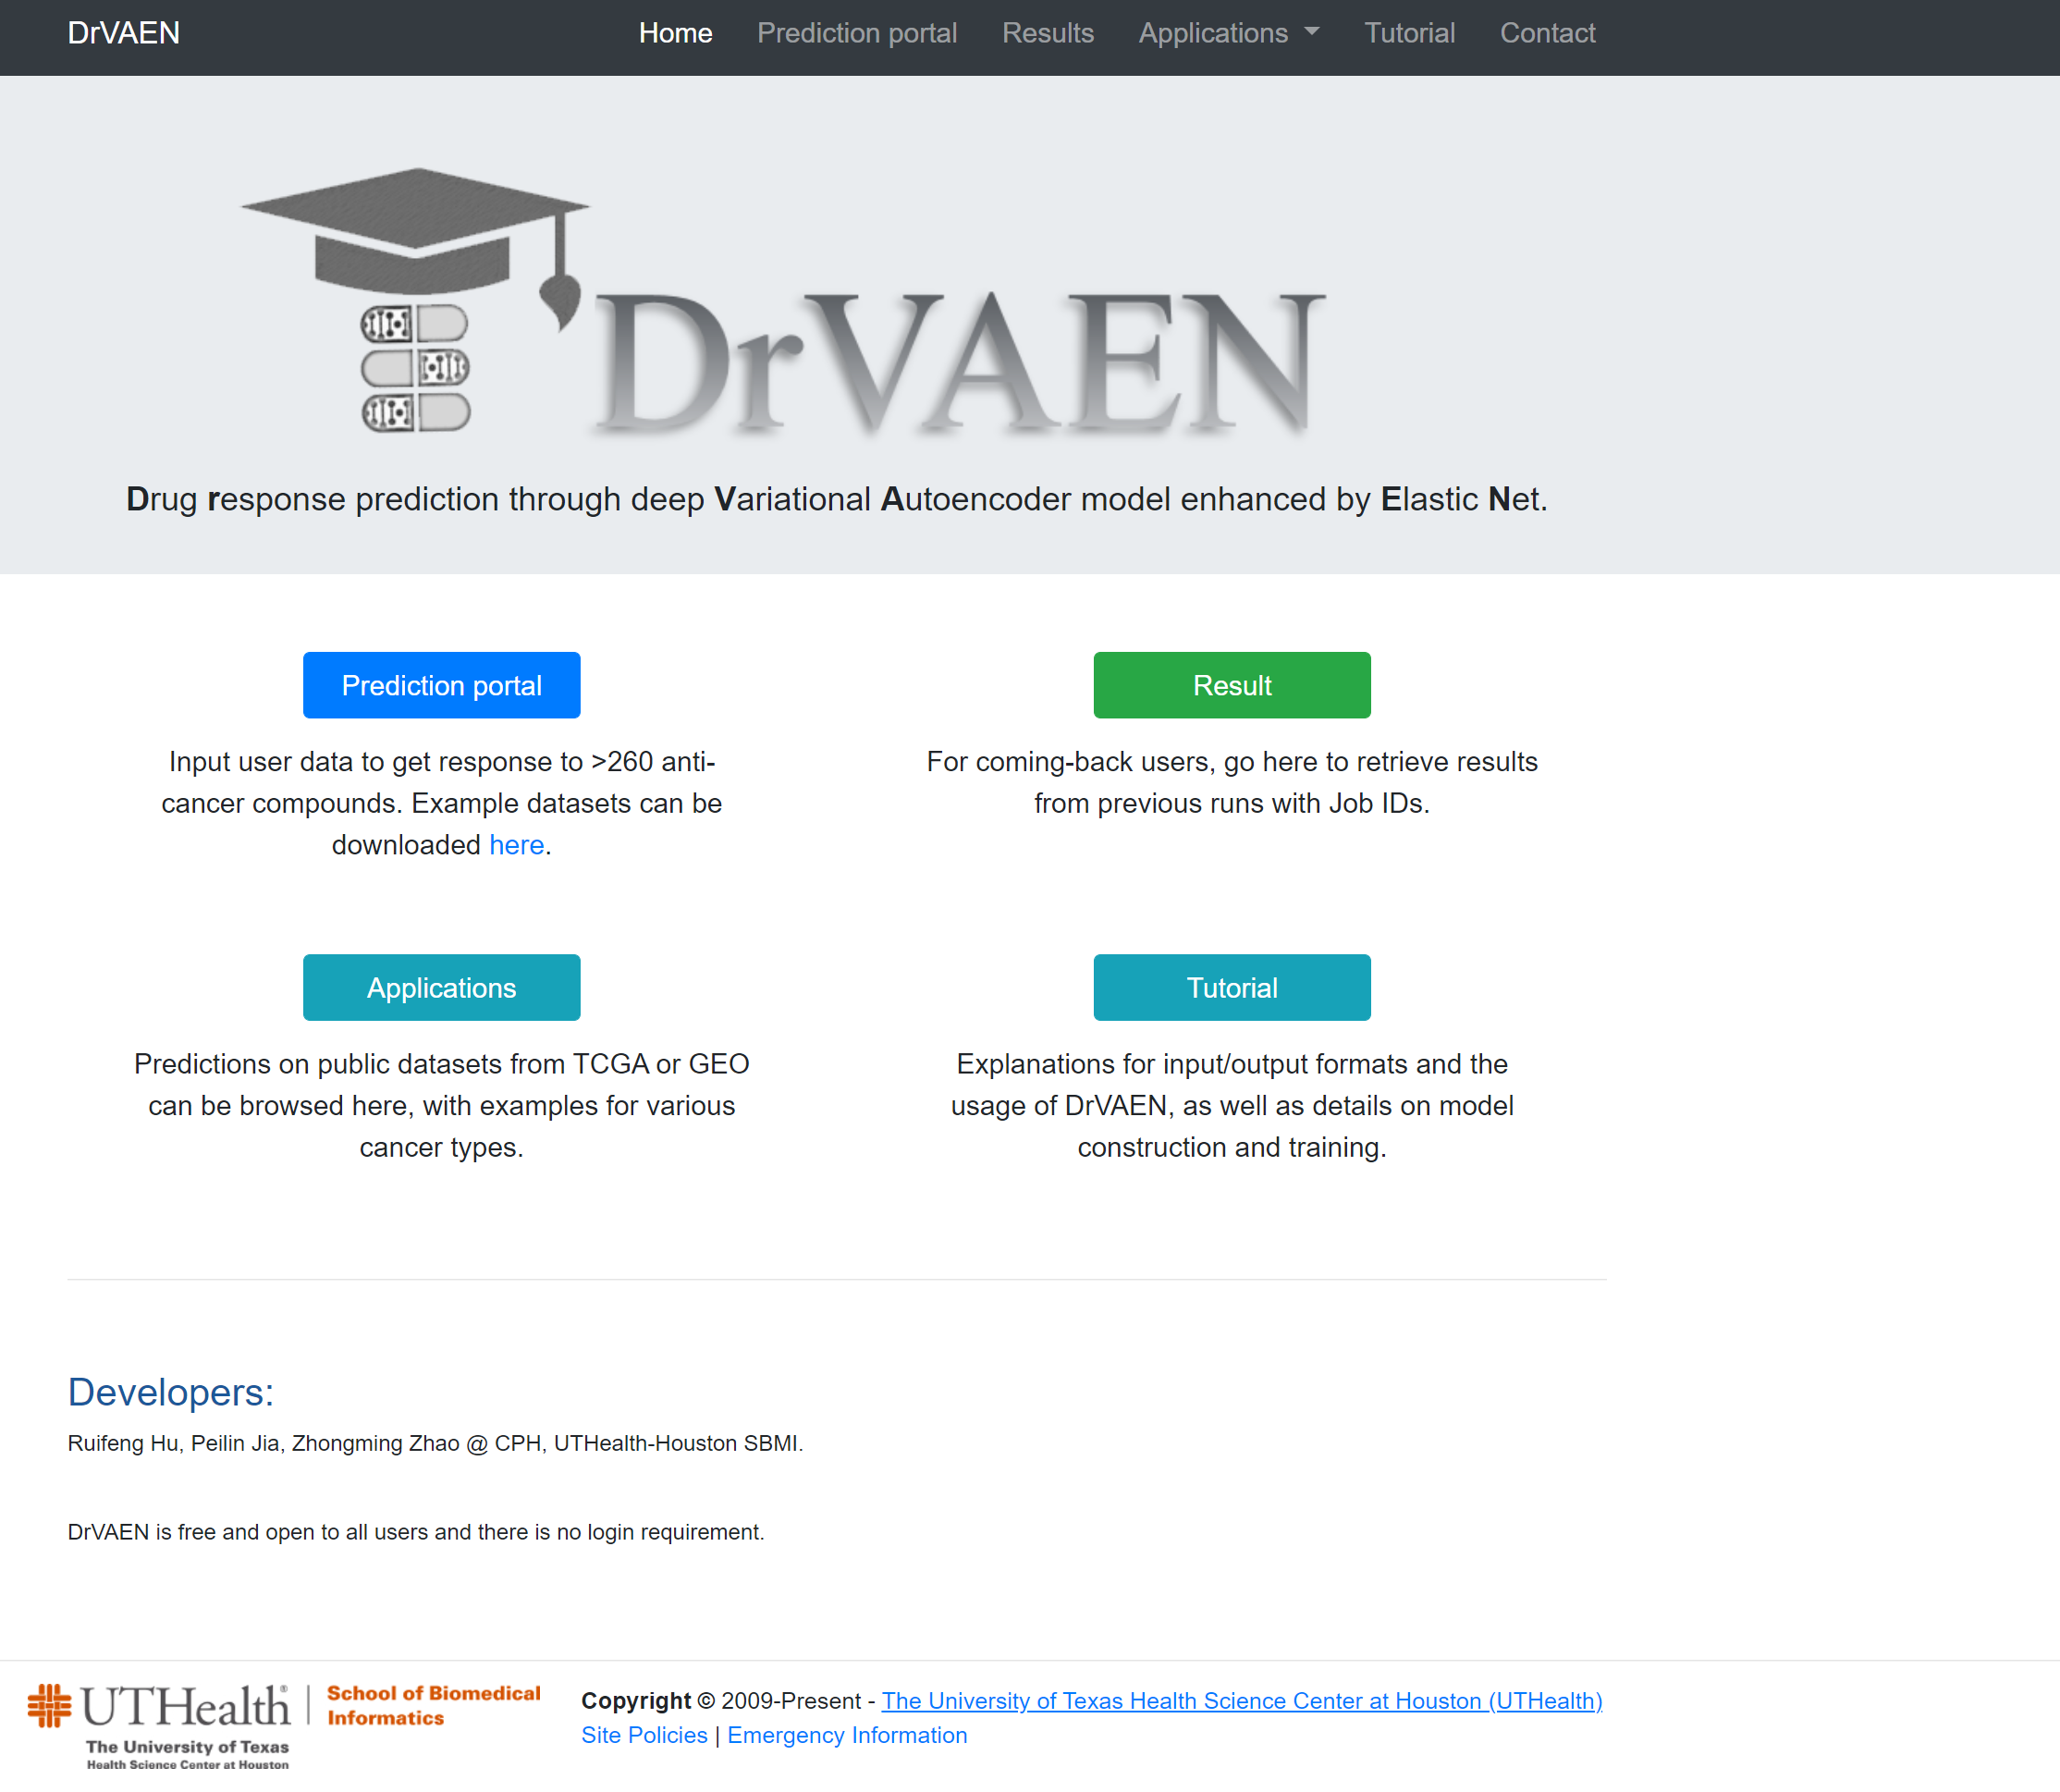
1.1 Go to DrVAEN online website
Visit DrVAEN at https://bioinfo.uth.edu/drvaen/
Google Chrome web browser is recommended
Home page

Slide 3
1.2 Functions on home page
Navigation bar / Menu
Click to start a new job
Retrieve the results with the Job ID
Check the application examples
Visit the tutorial page

Slide 4
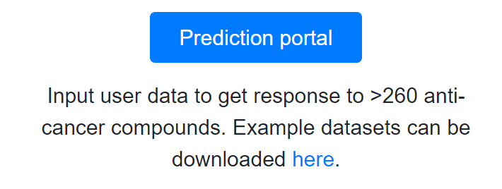
2.1 Start a new job
Click the “Prediction portal” button on the home page, or click the “Prediction portal” menu on the navigation bar to start a new job submission page.
OR
An example dataset is provided and can be downloaded through the “here” link.
Before submitting a job, you may check this file and make sure your submitted data has the same format as the example dataset (each row is a gene, and each column is a sample).

Slide 5
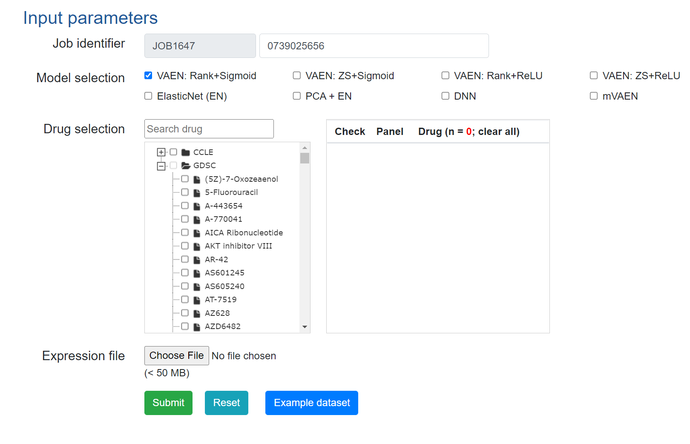
2.2 Submit a new job
Select the input parameters and submit the job (https://bioinfo.uth.edu/drvaen/tutorial.html#31F )
(1) Job identifier can be generated automatically or customized by the user.
(2) Select the models to run (the user must pick at least one model).
(3) Use the checkbox to select the drugs for running the model (maximum 50 drugs in each computational job).
(4) A gene expression matrix is required.
(5) Submit or Reset the job parameters (Reset will lose all the inputs data).
The user can also check the example dataset here.

Slide 6
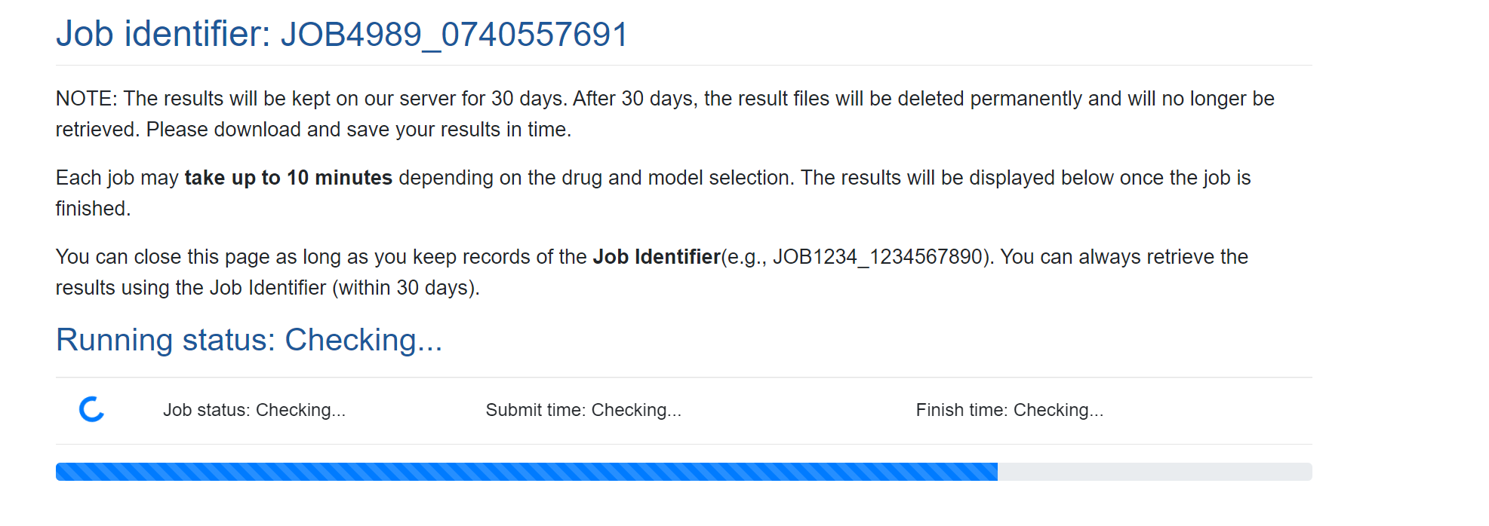
2.3 Wait for the results
After clicking the “Submit” button, the DrVAEN will first check the input parameters and upload the gene expression file to the server, then it will set up the job running environments and work on the job.
The user can close this page after she/he keeps records of the Job Identifier(e.g., JOB1234_1234567890), or the user can wait on this page until it is finished.
This page will refresh automatically and the results will be displayed on the page once the job is finished.

Slide 7
2.4 Results interpretation
A detail description is on our “Tutorial” page, Section “3.2. Output”.
Or the user can access it directly through this link https://bioinfo.uth.edu/drvaen/tutorial.html#32F.

Slide 8
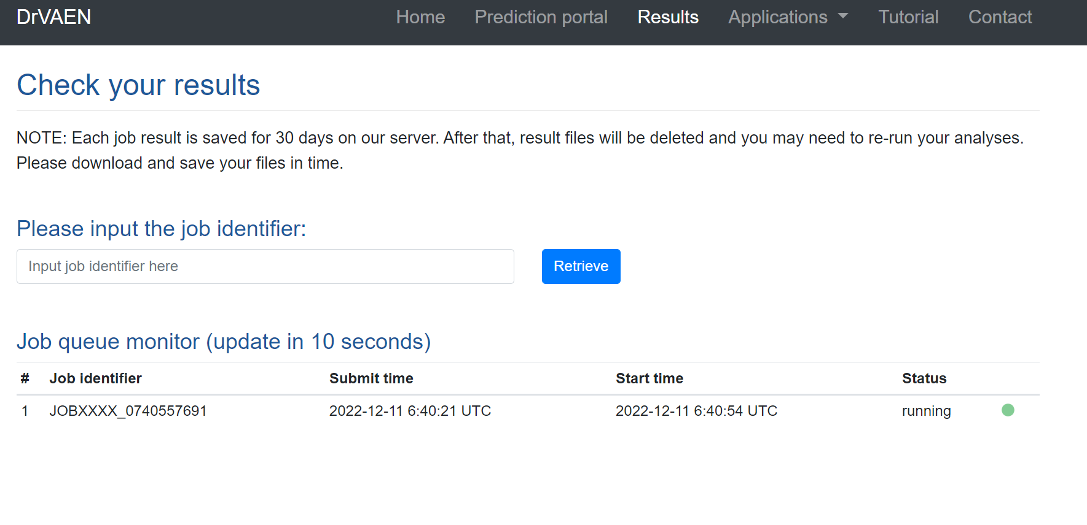
3 Retrieve your results
The Results page allows the user to monitor the job queue and the job ID is partially masked for confidential purpose (https://bioinfo.uth.edu/drvaen/tutorial.html#33F).
The user can check the specific job status/results by retrieving the job ID.
Input the Job ID to check the results
The results will be kept on DrVAEN server for 30 days. After 30 days, the result files will be deleted permanently and will no longer be retrieved.

